Slide 1
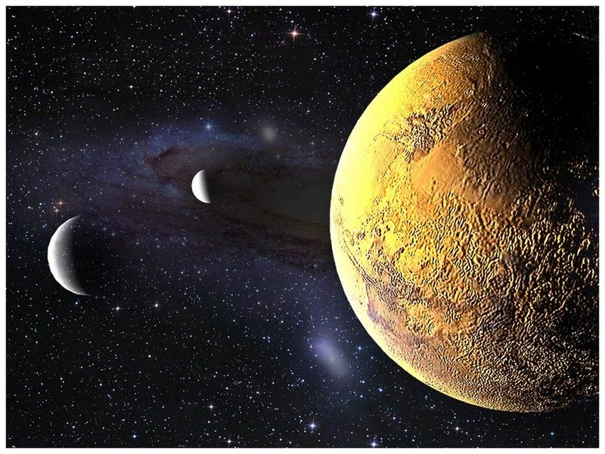
S.O.L.I.D.
Landing on Solid Ground
Philip Jordan
Nicolas Martin
Alec Deitz
Jason Alexander

Slide 2

Workshop Format
Katas
Lightning talk followed by exercise
Single Responsibility Principle
Open/Closed Principle
Liskov Substitution and Interface Segregation Principles
Dependecy Inversion
Introduced by Robert Martin (Uncle Bob) in
Principles of Object Oriented Design
Notes:
Principles of OO Design - 2003

Slide 3
S.O.L.I.D.
Single Responsibility Principle

Slide 4
Definition
A class should:
have all of its services narrowly aligned
only ever have one reason to change
Notes:
The same piece of code shouldn’t have to change twice. For instance, a piece of code shouldn’t change if the format changes and the data source changes. It should only be one of these

Slide 5
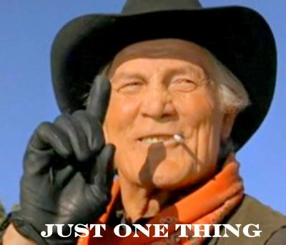
Why? High Cohesion
Robust classes
Improved code reuse
I’m lost - too much going on!
Notes:
High cohesion speaks to all the different parts in your classes working together – think of how rover only has rover things

Slide 6
Why? Change Agents
Know where in the code to make a change
Responsibilities tied to people
Understand your change agents (the people)
Unaffected by “ancillary changes”
Confidence in your code
Notes:
Change agents are pretty much the motivator for changes, usually driven by requirements changes by someone. Want to make sure change agents have their own space

Slide 7

How?
Break it down!
Notes:
Large methods into smaller methods
Large classes into smaller classes
Separate concerns & reassemble

Slide 8

How?
Look for opportunities for reuse
Notes:
Look for patterns
Abstract common functionality
Introduce helpers

Slide 9
How? Code Smells
Methods of greater than 5 lines
Conjunctions in names: And/Or
More than 3 words in a method
Lines of code in a class
You should never get lost
Multiple actors with multiple goals
Copy-paste programming
Notes:
Methods should practice SRP too. More than 5 lines means it is probably doing multiple things.
Examples:
LogOrEmailError - see this a lot. Method has 2 paths based on some condition, where the fork leads to 2 separate responsibilities. Although only one responsibility may execute at a time, both responsibilities are coupled to the method.
Example:
ParseInputForDatabase - Probably need code whose responsibility is parsing, and perhaps an abstraction of “Database”. Reminder: look for patterns. If you need to parse for other systems besides the database, consider a polymorphic pattern where each class is responsible for parsing for its own system.
If your class is sufficiently cohesive, you shouldn’t have to keep scrolling around trying to find what you are looking for.
Example:
The account department wants X, Y, and Z fields stored in the database
The IT governance committee insists on columns Y and Z to be encrypted
One class is responsible for persistence (saving to the database) and one class is responsible for securing the data

Slide 10
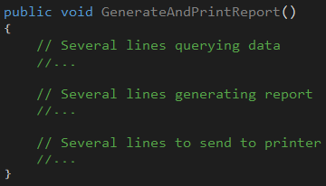
Examples
What happens if….
data store changes?
report format changes?
output changes?
Notes:
Reponsibilities should be separated out to other classes
Consider passing classes that handle other reponsibilities

Slide 11
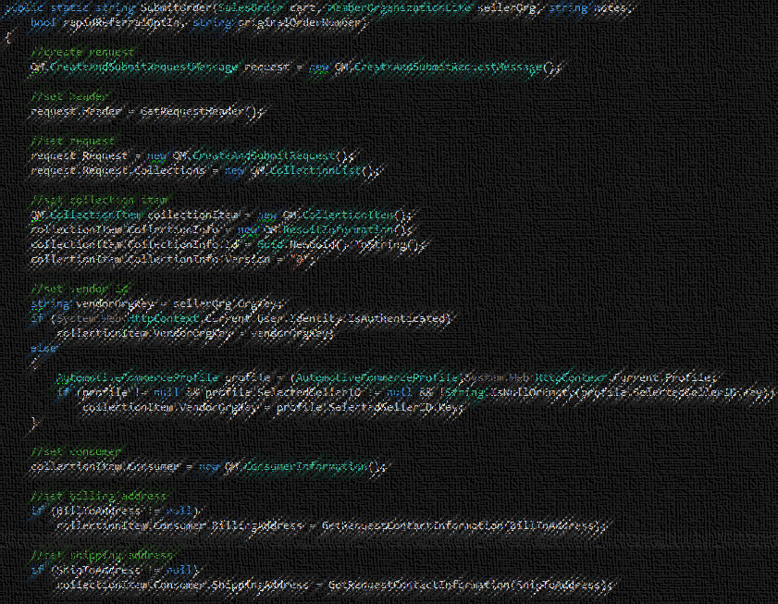
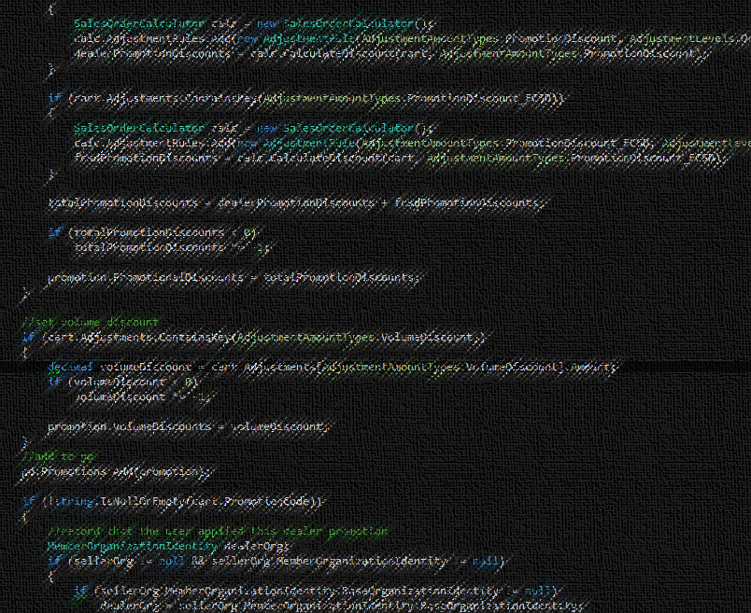
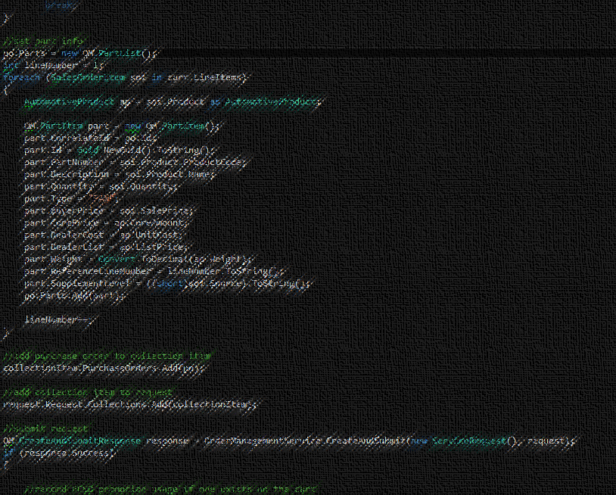
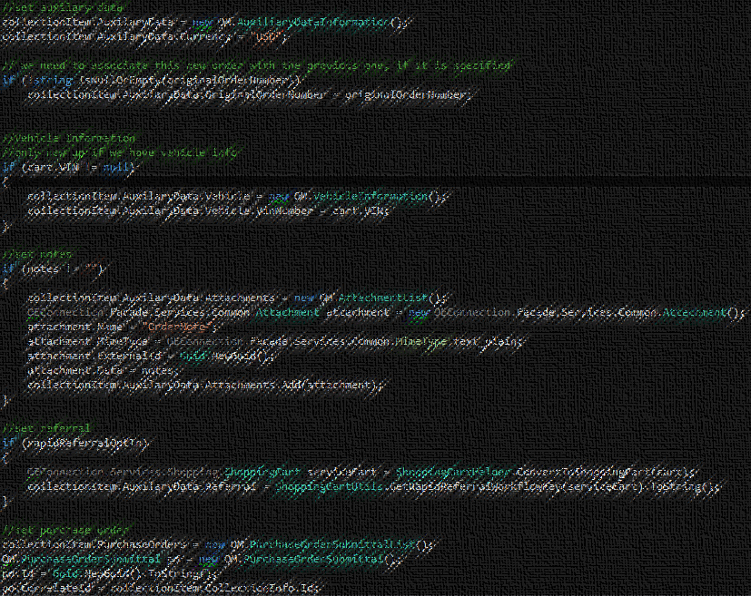
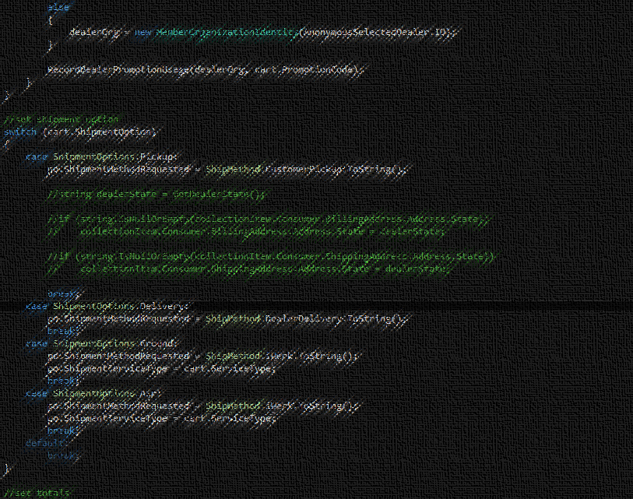
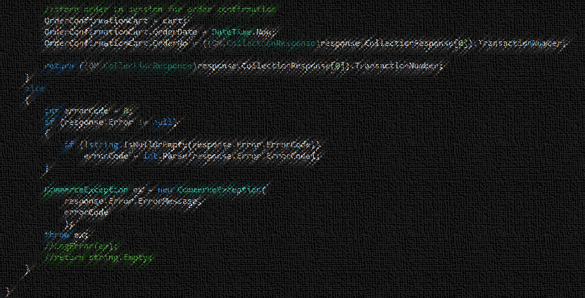
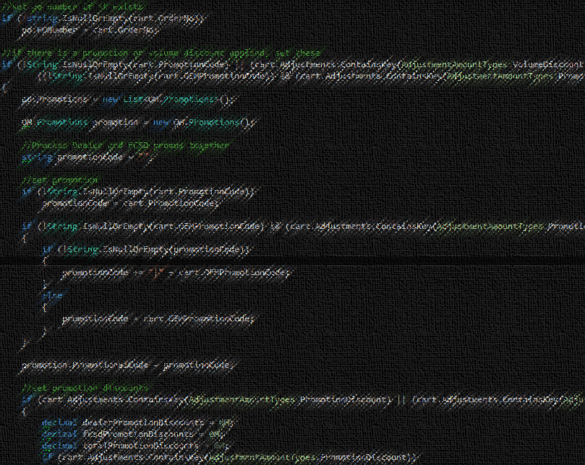
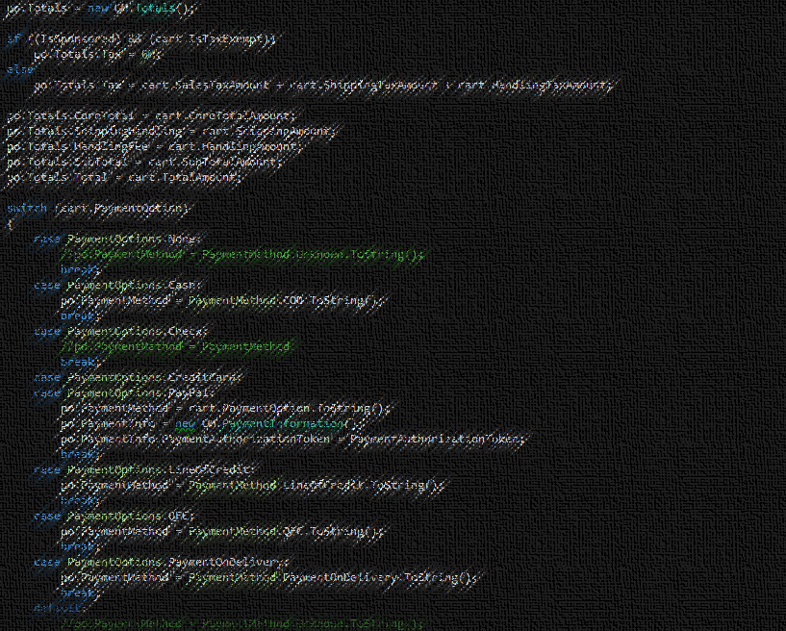
Examples
What does this do?!
Parsing
Mapping
Database interactions
Transaction management
etc., etc., etc.
Notes:
157 lines of code – in production.
Many other methods like this
Developers terrified of making changes.

Slide 12
Recap - Definition
A class should:
have all of its services narrowly aligned
only ever have one reason to change

Slide 13
Kata – Mars Rover
.NET and Java
Two functional code bases
One with no respect to SRP
One implemented with SRP in mind
Groups of 3 or 4
Good mix of experience level
Try not to “cheat”
Refer to SRP reference implementation later

Slide 14
Current Rover Responsibilities
Its own movement
Planet’s properties
Managing obstacles
Validating positions
Instructions
Create Mars class
Move Mars behavior out of the Rover class to a Mars class
Refactor Rover to take a Mars instance in the MissionController class
- Rover
- Mars
- Mars
- Mars

Slide 15
Possible Solution
Rover
Rover
Mars
Movement
Mars Landing
Boundaries
Coordinates
Obstacles
Separation of concerns
Methods put in classes that make logical sense
Notes:
Talk to these being the types of methods that get split out and not the methods themselves

